Slide 1
CENTERS of HOPE in Ukraine
A Note: the Slides contain videos!

Slide 2
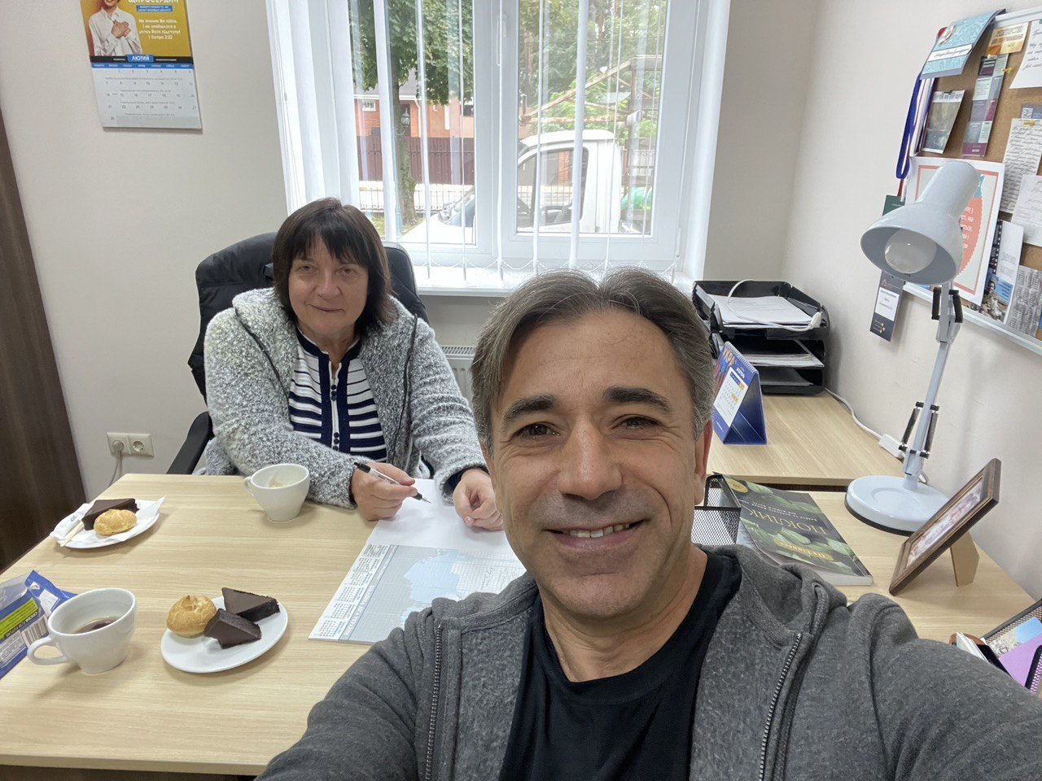
Brother Furta the denominational vice president working with Vira our CoH Administrator

Slide 3
In Carpathians – a new Center of Hope by VasYl & Maria
This couple just sold their business (a store) to start a Center of Hope in another town

Slide 4
Надіі = HOPE, we bring HOPE into a WAR TORN society

Slide 5
using CoH songbooks
All our songs have background pictures
Songs with pictures
Help MEN to sing

Slide 6
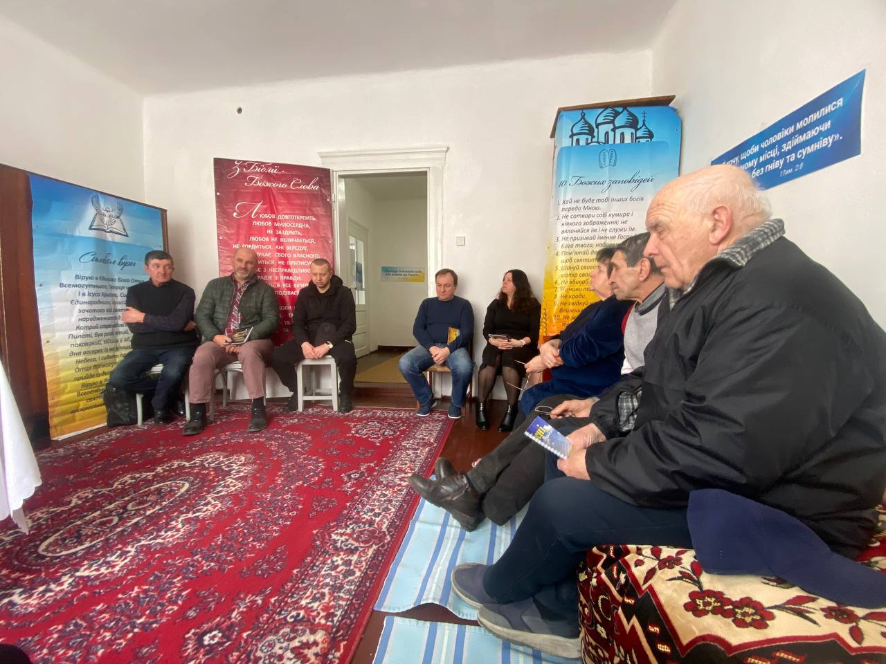
Our Focus is Reaching MEN
This shows our Banners & Posters

Slide 7
The town ZvIaHel – a Center of Hope by Edward & Catherine
Reaching the Community

Slide 8
The village KyrYlivKa – a Center of Hope by Mykola & TetIana

Slide 9
The town Izium – a Center of Hope by Vitalii & TetIana
A Center of Hope in the midst of a WAR zone

Slide 10
In Izium – Coffee and snacks – setting up for a outdoor Gospel meeting with 300 people

Slide 11
Isolated and hungry, people are in dire need of everything – electricity - heat - food – medicine – clothing – but spiritual nourishment most of all
Mid-winter sitting in a cold tent

Slide 12
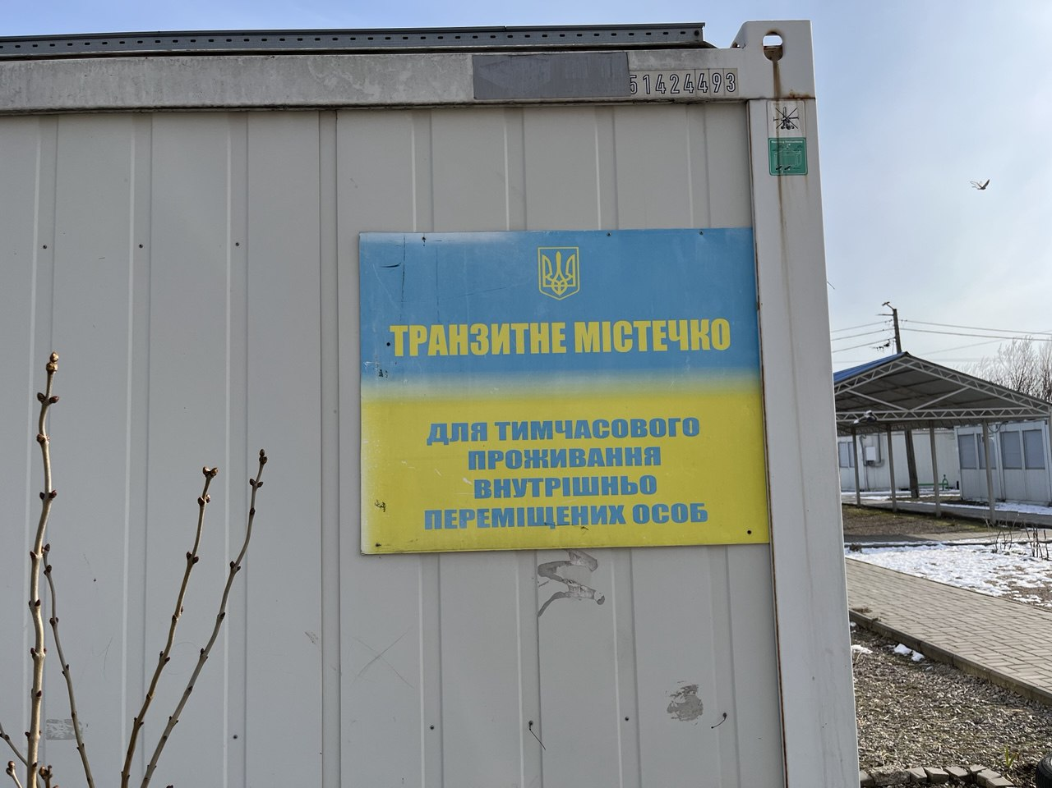
Zaporizhzhia province – a Center of Hope by Mykhailo & OlIa
A new town of 200 prefab mobile units for refugees – a new Center of Hope begins. This old pastor is a refugee himself

Slide 13
Humanitarian aid with the Gospel

Slide 14
The city Zaporizhzhia – a Center of Hope by Andriy & SnIzHana
Unbelieving teenagers excited about doing spiritual homework

Slide 15
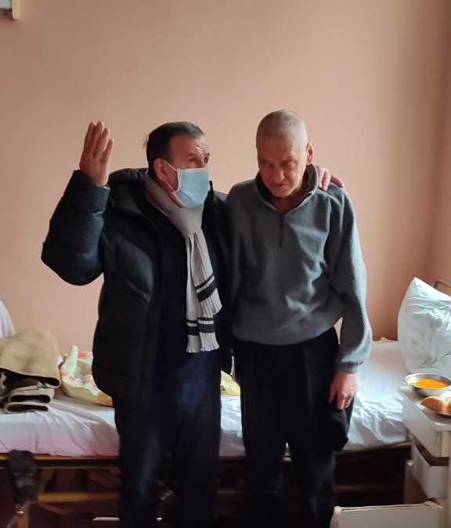
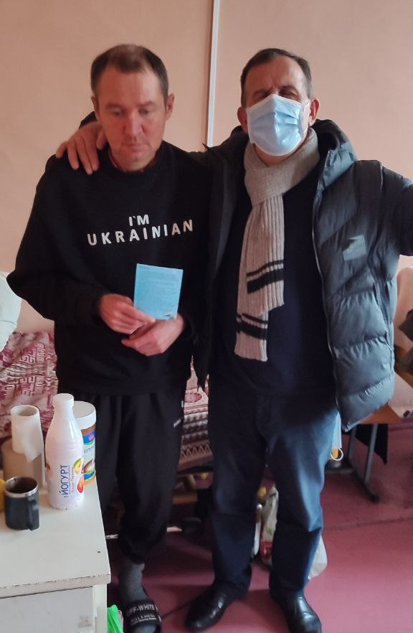
The town Zaporizhzhia – evangelist Valera in hospital
1
3
Prayer to be Born-Again
Praying for restoration
Praying is the main ministry of Centers of HOPE
2

Slide 16
The city Cherkasy – a Center of Hope by Serhiy & Victoria Focusing on youth ministry

Slide 17
The city Mykolaiv – a Center of Hope by Volodia & Nadiya
A Baptism – with a gift of our shirts
Which say : “if you want to go to heaven ask me”

Slide 18
The city Dnipro – a Center of Hope by Dima & Anna Studying “How to begin a new Life.”

Slide 19
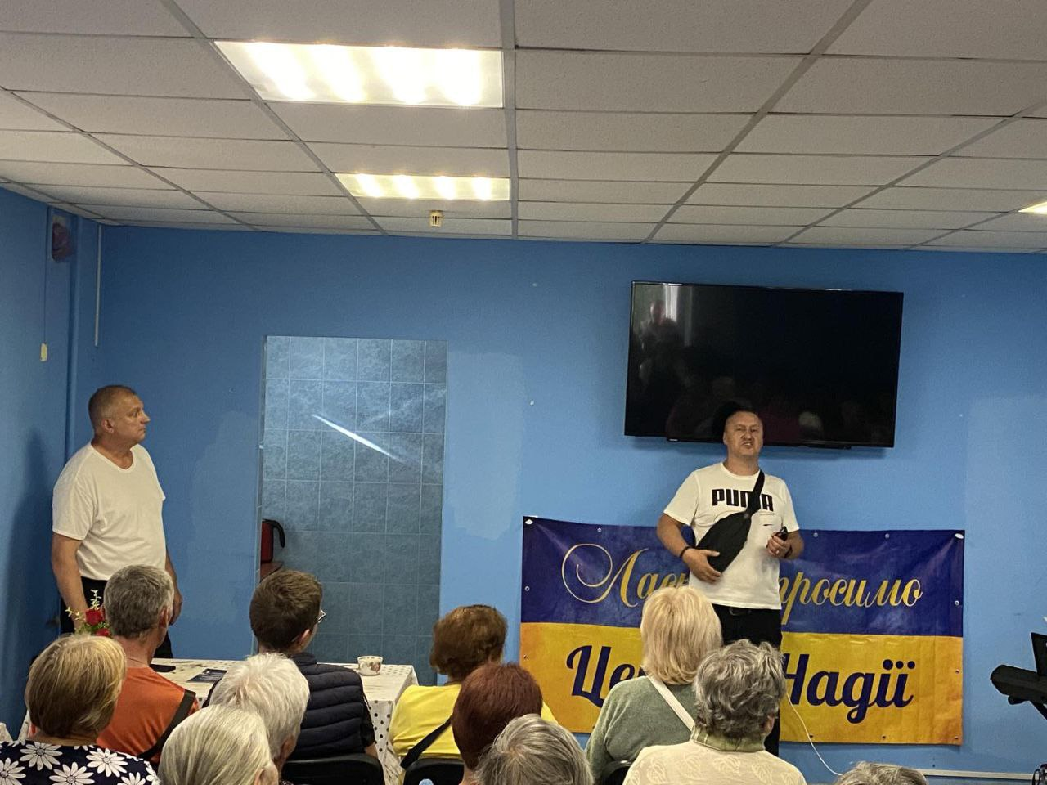
The city Konotop – a Center of Hope by Anatolii & Nadiya
A refugee pastor excitedly starting a CoH ministry
80 are already attending

Slide 20
The city Kyiv – Participating Youth Evangelists ZHenIa & Katia
Doing very effective YOUTH Work

Slide 21
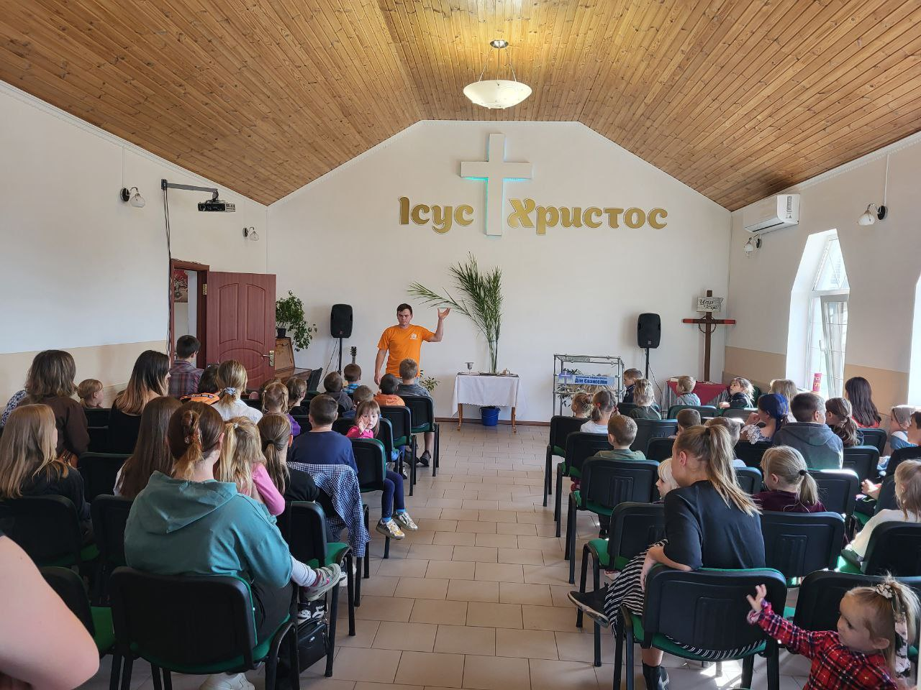
The city Dnipro – a CoH successful Failure by Dima & Katia
An old pastor sidetracked Dima to become pastor – but already 30 are saved - hallelujah!

Slide 22
The town NOVYI BYKIV – a Participating Church Plant by Kolia & Lena
A wonderful couple – PRAY for a breakthrough

Slide 23
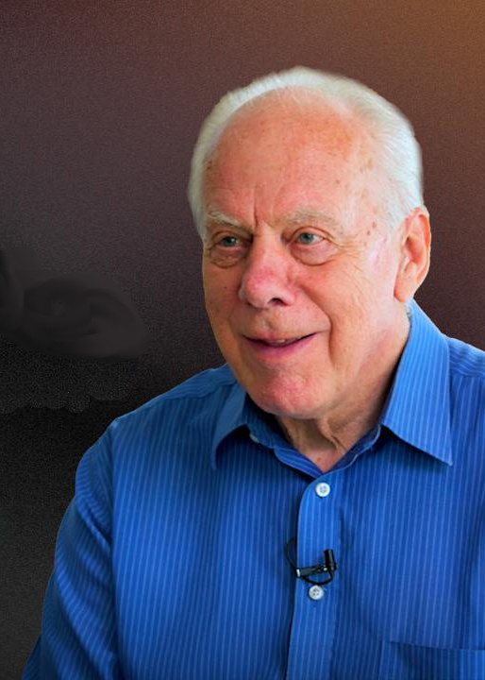
With ebu president AntonIuk looking into the future
We are contemplating to start a New Life ACADEMY for a more intensive ministry training young pastors

